Slide 1
Sign & Spell VR
Irish Sign Language Learning in Virtual Reality
Karl Negrillo
C22386123
BSc Computer Science International
Supervisor: Colette Kirwan

Slide 2
Project
VR app using hand tracking.
Teaches Irish Sign Language alphabet, words, maybe even sentences.
Meta Quest 3/3S with real-time feedback.
Local Progress Tracking.

Slide 3
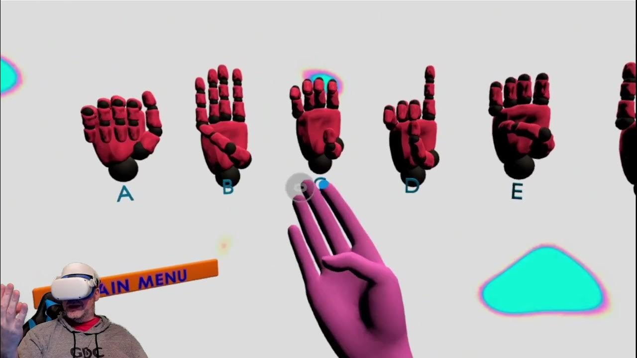
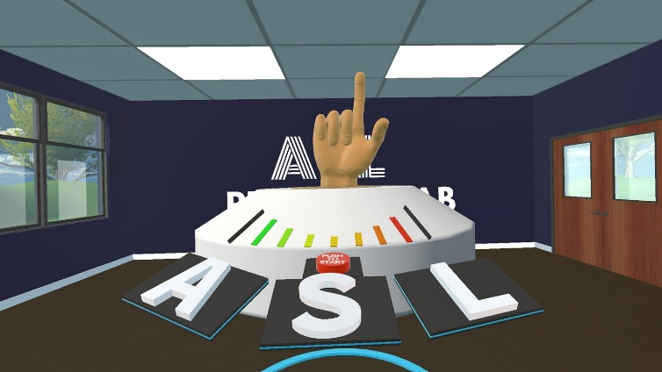
Background
Existing Solutions: ASL FingerSpeller, Silent Classroom VR
Why Different:
  ISL Focus
  Common Words, in the future, sentence making
  VR Immersion
Less Common than ASL – Fills a Gap
Ethical Approach: Designed with Deaf community input, respects ISL cultural significance & accuracy (vs avatars as substitute)

Slide 4
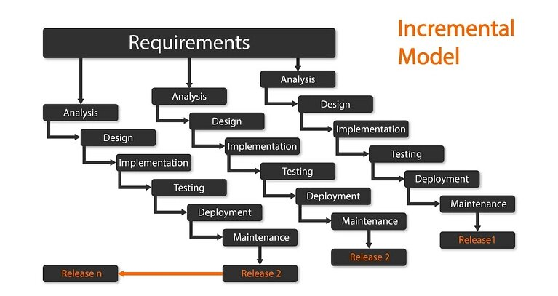
Methodology
Incremental Model
  Core Features:
    Increment 1: Real-Time Hand Tracking, recognition of basic ISL Letters, Real-Time Feedback
    Increment 2: Common Words, Common Sentences, Improve UI
    Increment 3: Data Saving

Slide 5
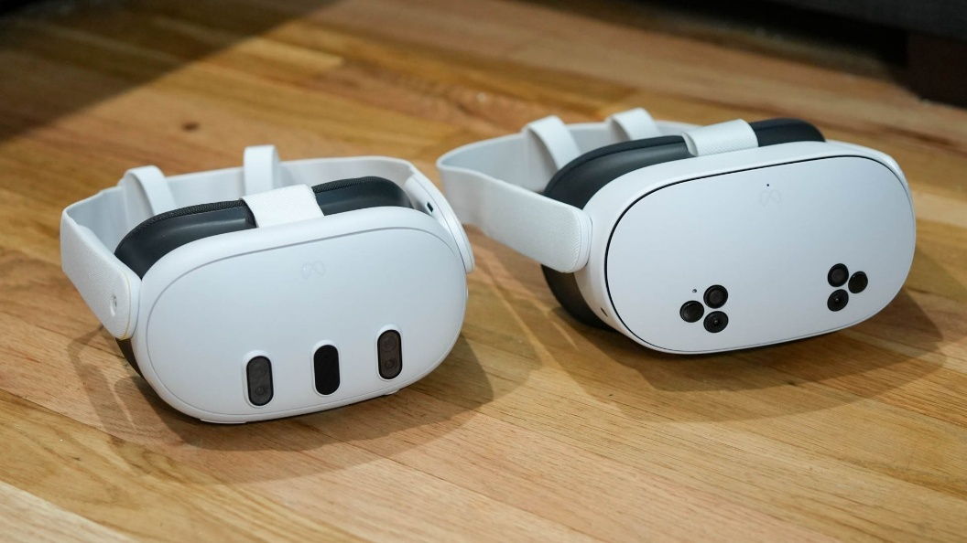

Technologies
Operating Systems(s): Meta Quest 3/3S (VR headset OS)
Programming Language(s): GDScript
XR Framework: OpenXR
Data Storage: JSON (local)
Game Engine: Godot 4

Slide 6
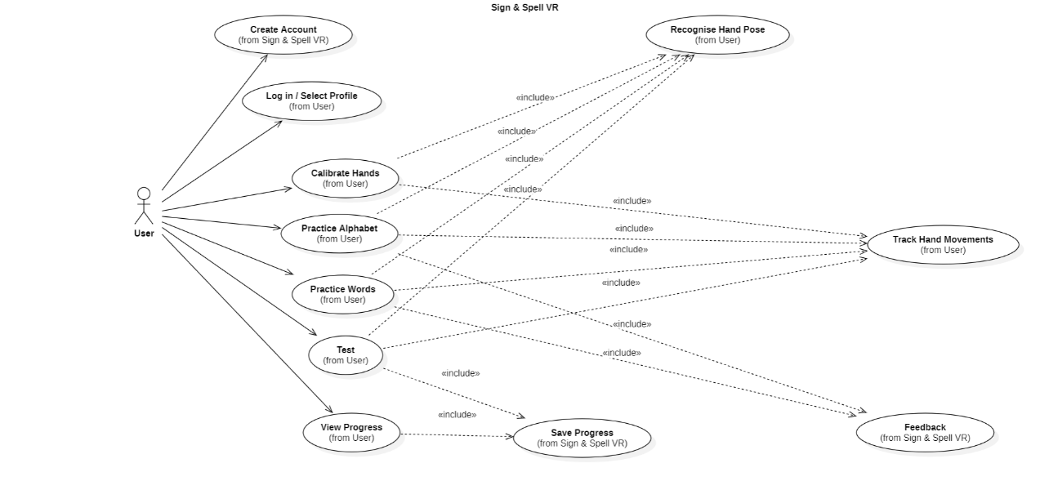
System Requirements
Requirements
  Stakeholder Interviews: Learners, Deaf Community, Teachers
Functional
  Hand Tracking, Sign Recognition, Feedback, Progress Storage
Non-Functional
  Low Latency, accessible UI, intuitive design
Use Case Diagram

Slide 7
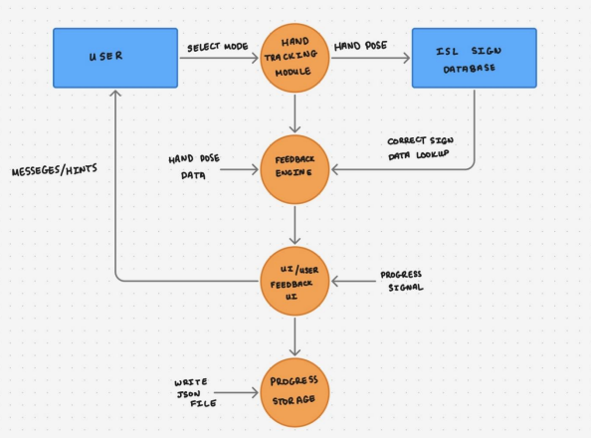
Technical Architecture
Standalone VR application on Meta Quest 3/3S
Hand tracking → Recognition → Feedback → Storage
Data Flow Diagram

Slide 8
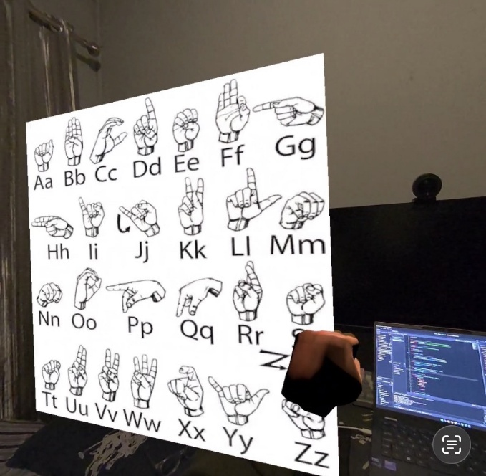
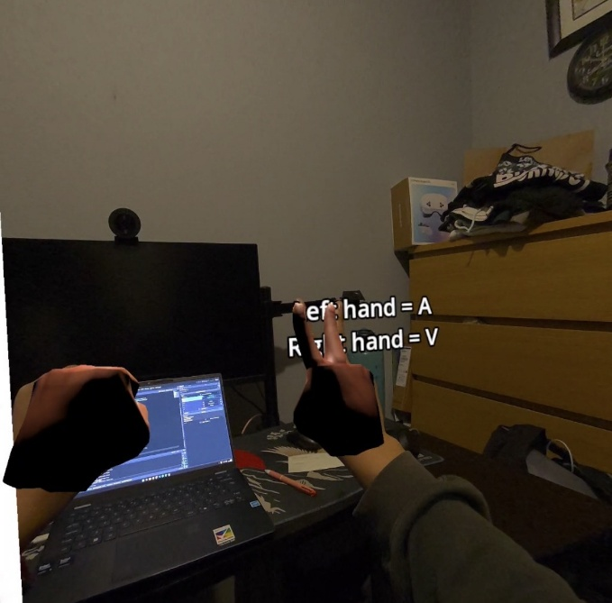
Front End Design
Simple VR room with floating ISL alphabet reference board.​
Passthrough view shows user’s real room plus virtual ISL hands.
Live virtual hands mirror the user’s hands for practice and feedback.
On‑screen text shows detected letters for each hand in real time (e.g. “Left hand = A, Right hand = V”).

Slide 9
Middle Tier Design
Hand Pose Detection: OpenXR sensors detect finger positions in real-time
Gesture Matching: Compare user hand pose to stored ISL sign database
Confidence Validation: Check if pose matches threshold for correct/incorrect
Real-time Feedback: Generate visual feedback (correct/try again) instantly
Rule-based recognition: simpler, faster setup

Slide 10
Back End Design
Local JSON files store user calibration, progress, and settings on the Quest headset.​
One JSON structure per learner: user info, hand‑pose calibration, learned alphabet letters, and simple stats.​
Accessed through Godot 4’s FileAccess API in the user data path (no external DB).​
Designed so the same JSON can later be sent to a cloud service for sync without changing the data model.​

Slide 11
DEMO HERE
DEMO HERE

Slide 12
Evaluation Criteria
“A”, “V”, and “D” is readable from hand-tracking on both hands.
Feedback works when user signs “A”, “V”, and “D”, shows Left Hand = “A”/”V”/”D” and Right Hand = “A”/”V”/”D”
User can complete a short practice session (A, V, D) without confusion or crashes.

Slide 13
Future Work
Increment 2 (Immediate):
  Complete remaining alphabet letters A-Z
  Better Visualisation of the UI Environment
Increment 2 (Christmas):
  Implementing User Account Creation and Hand Calibration
  Implementing Common Words
Increment 3 (Post-exams: Late Jan–Late Feb):
  Local Data Saving
  Test Page
  User testing & refinement

Slide 14
Thank you!
?
Questions
?

